Slide 1
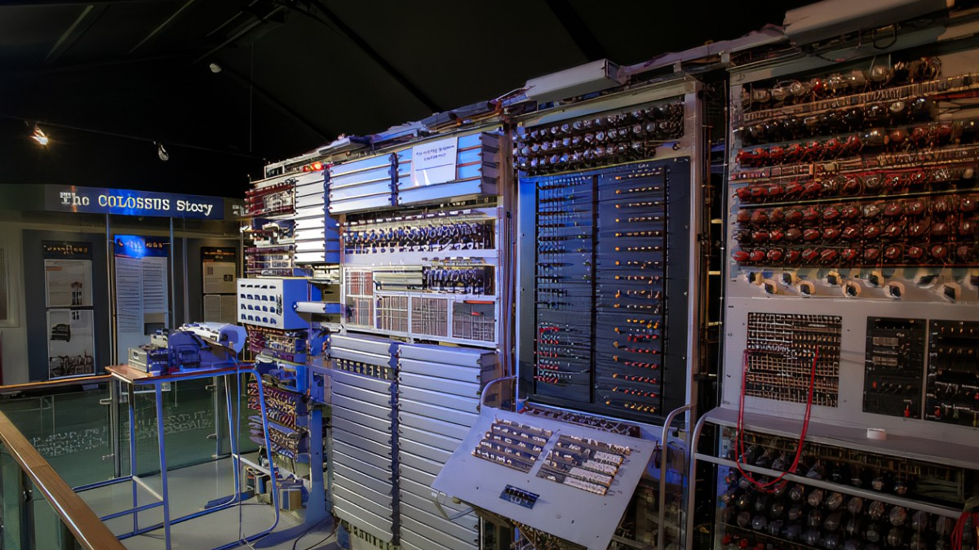

Bletchley Park 2022
A Microsoft 365 Community COLLABORATION CONFERENCE
Wednesday, 5th OCtober 2022

Slide 2
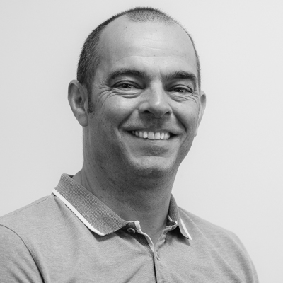
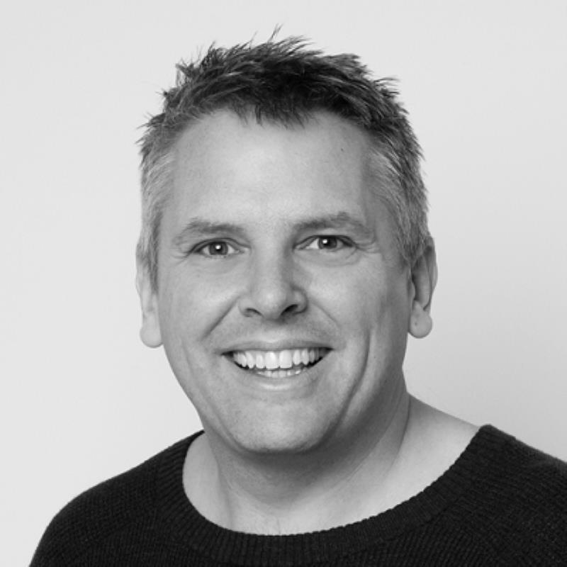
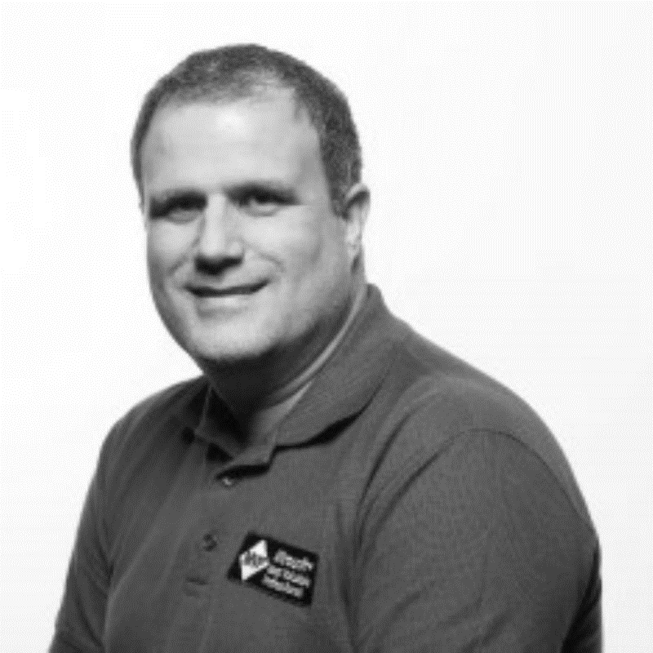
About US
Collabdays is a one-day regional community event and sister to the larger CollabSummit that takes place in Europe and the United States. The organizers; Tony Pounder, Paul Hunt MVP, and Brett Lonsdale (MVP) have successfully hosted Collabdays Birmingham, and formerly SharePoint Saturday UK every year since 2010. Collabdays makes it possible for attendees to visit an event within their region, whilst learning from some of the best Microsoft 365 speakers.

Slide 3
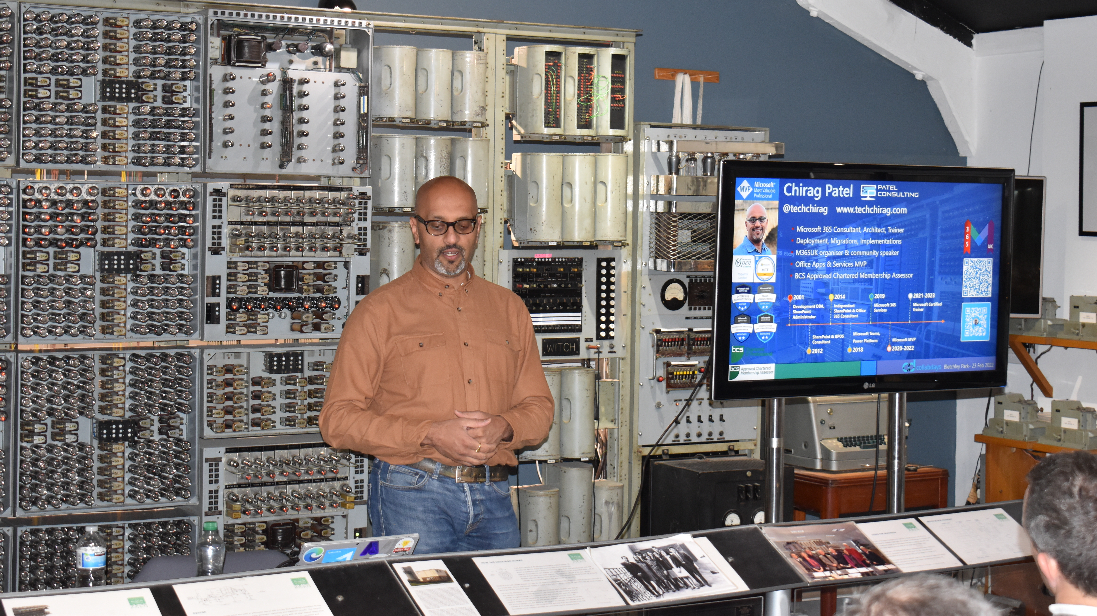
Collabdays offers attendees THE CHANCE to learn about Teams, SharePoint, The Power Platform and Azure

Slide 4
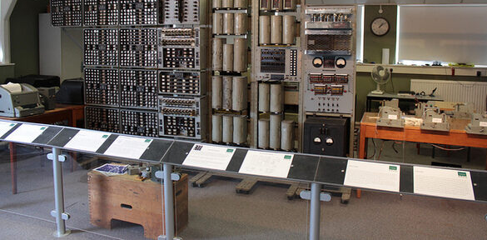
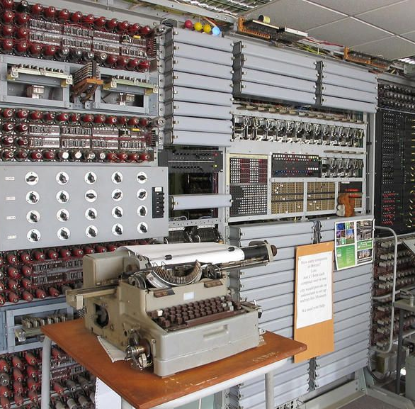
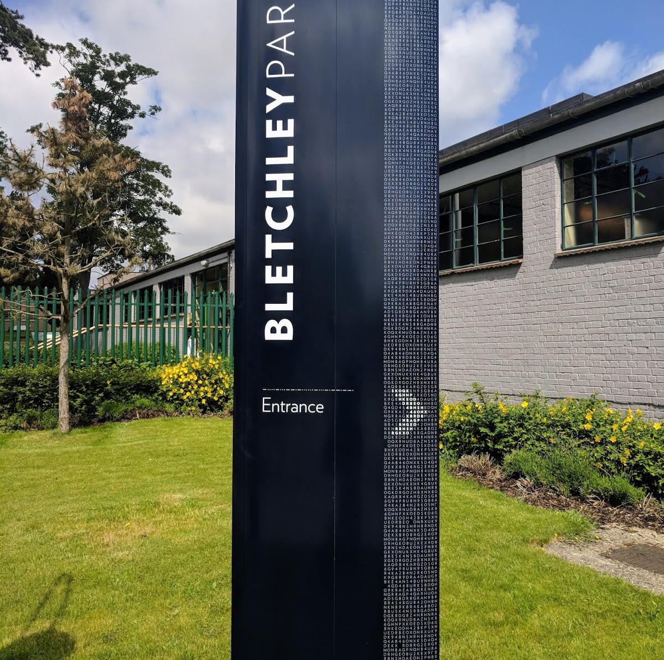
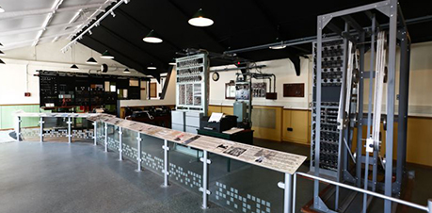
The Venue – National Museum of Computing UK
The National Museum of Computing (TNMOC) is home to the world's largest collection of working historic computers.
One of England’s top 100 irreplaceable places
Home to the Turing-Welchman Bombe & Colossus of the 1940’s
See the rise of computing through the 50’s, 60’s, 70’s, and 80’s

Slide 5
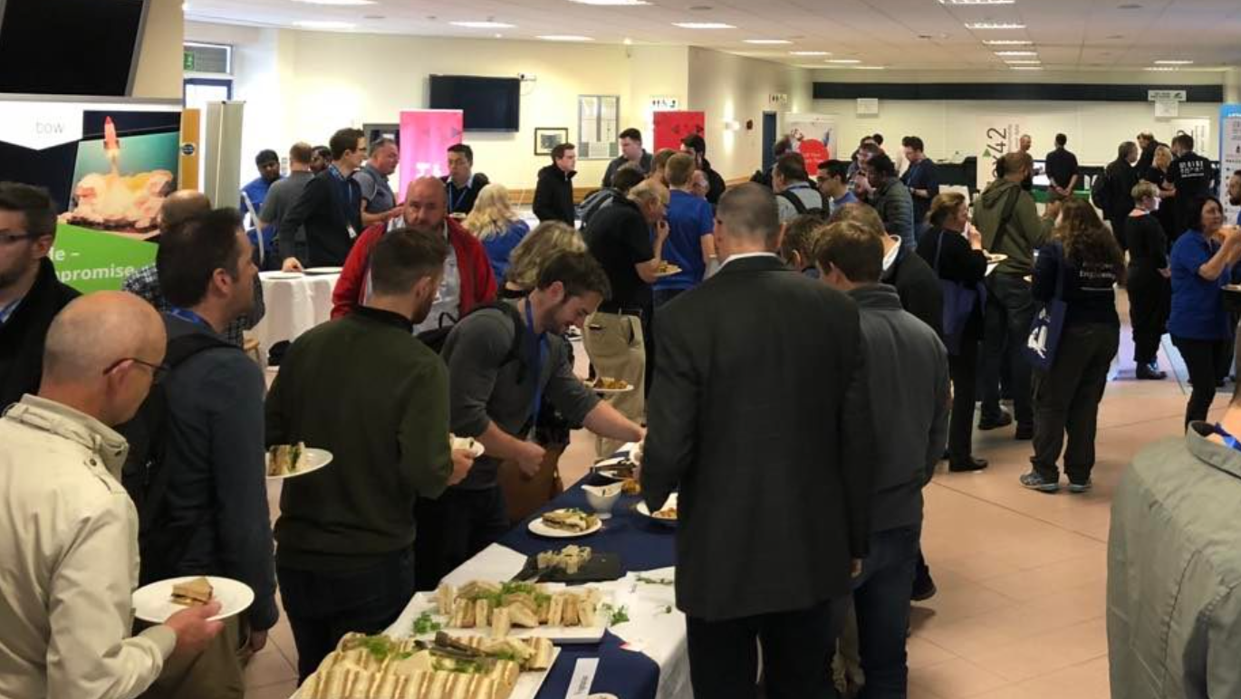
Sponsors
All proceeds from the sponsorship will help towards the running costs of the National Museum of Computing, and to help fund the Ambassador Kids program to inspire the next generation of technology leaders.
Each Platinum or Gold sponsor can exhibit through many of the different rooms at Collabdays. This helps to avoid a central gathering, but also guarantees through traffic through the museums one way system to your stand.

Slide 6
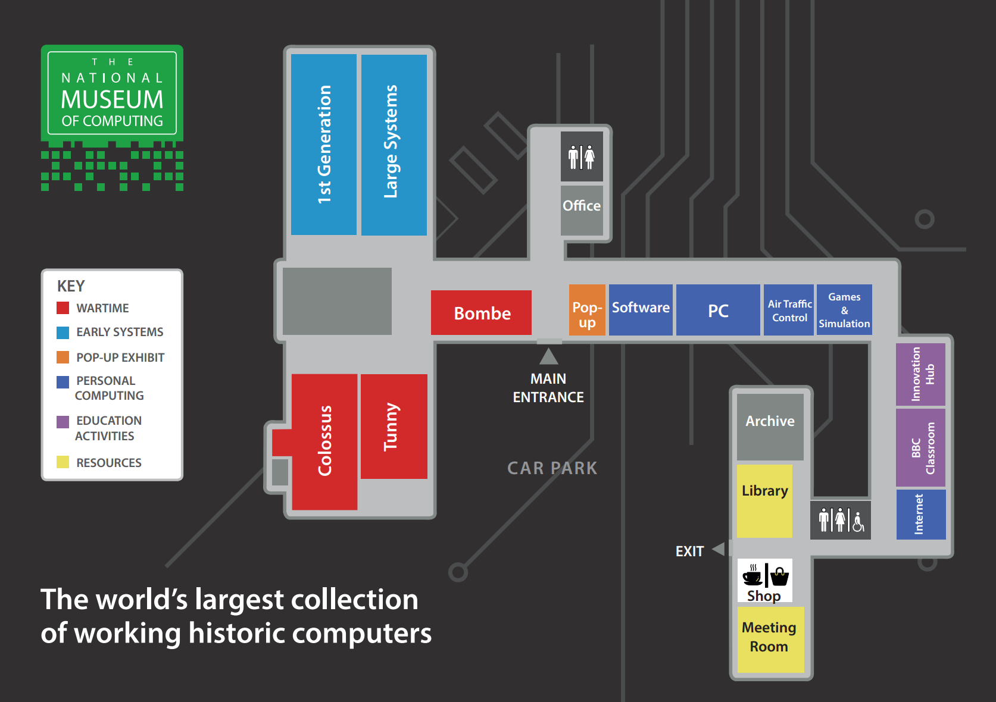
Sponsorship options
 | Platinum x 2 | Gold x 4 | Silver x 4 | Online
Booth Area | Prime Location 12ft wide space Table and 2 x Chairs + Electricity & WiFi | 6ft wide space Table and 2 x Chairs + Electricity & WiFi | Table and 2 x Chairs + Electricity & WiFi | N/A
Logo on all Session Slides | Included | Included | Included
Opt-In Attendee List | Included | Included
Logo on Collabdays Website | Included | Included | Included | Included
Social Media Announcements | 4 rounds | 2 rounds | 2 rounds | 1 round
Number of Museum Passes | 4 | 3 | 2 | 0
Package Price | £1750.00 | £1250.00 | £1000.00 | £250
Additional Options | Price
Lunch Sponsor with Branded Napkins | £1000
Lanyard Logo (1 Available) | £500
Coffee/Tea Sponsor with Branded Cup Cakes | £500

Slide 7
Plan of the Day
7:30 – 9 am
Sponsor Setup
9 am
Keynote Museum Tour of Computers through the Decades
10 am
Session with 15 minute break for refreshments and browsing the museum/sponsors
11:15 am
Session with 15 minute break for refreshments and browsing the museum/sponsors
12 noon
Lunch – Street food and browsing the museum/sponsors
1 pm
Session with 15 minute break for refreshments and browsing the museum/sponsors
2:15 pm
Session with 15 minute break for refreshments and browsing the museum/sponsors
3:30pm
Session with 15 minute break for refreshments and browsing the museum/sponsors
4:45 pm
Session with 15 minute break for refreshments and browsing the museum/sponsors
5:45 pm
Closing Note & Prize Giving

Slide 8
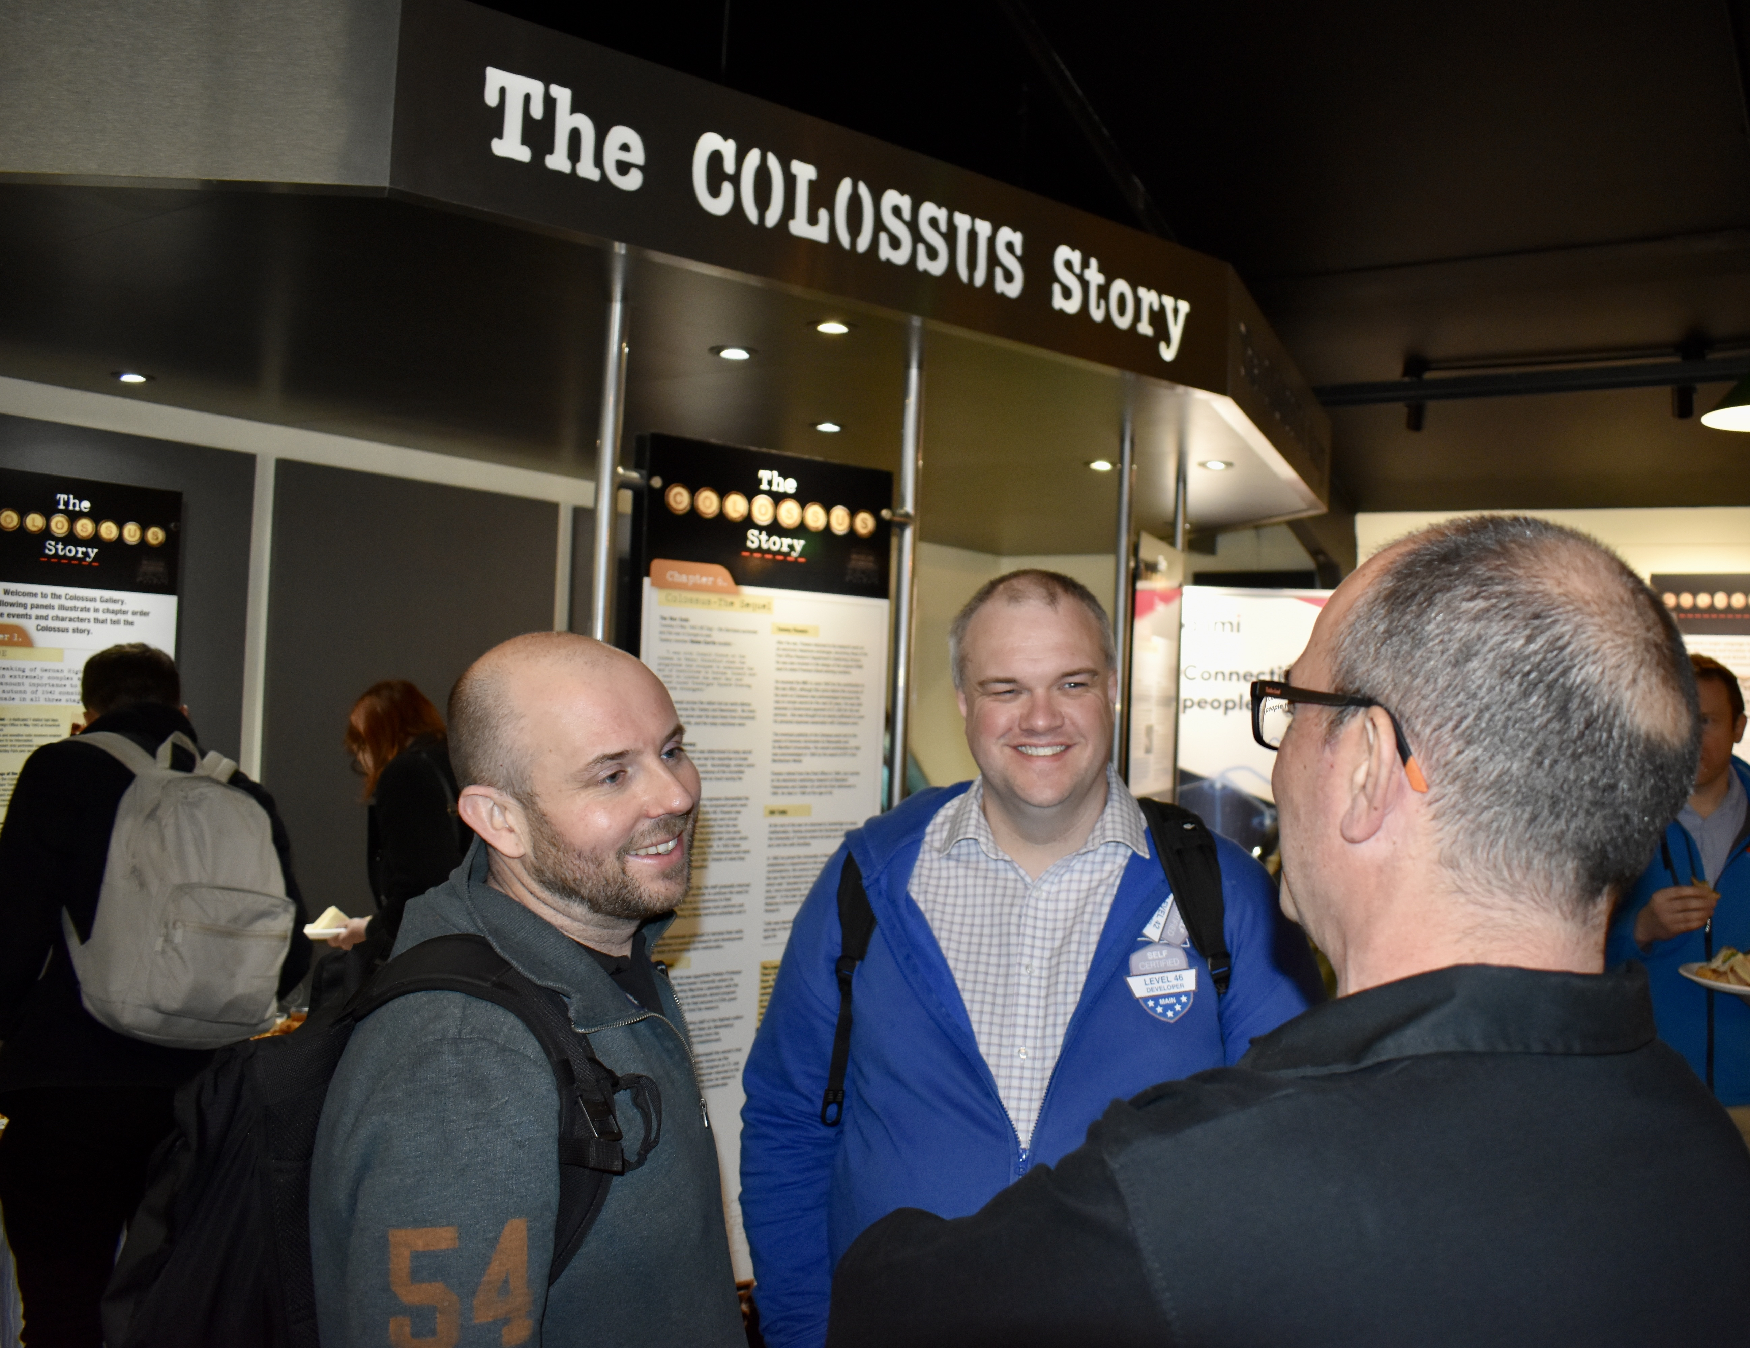
Goals
140 In-Person Attendees
25 Speakers
25 Sessions
Safe Environment
£10,000 in funds raised to support the National Museum of Computing

Slide 9
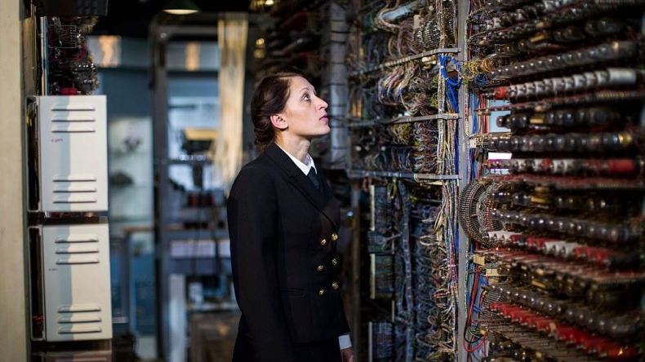
Ready to Sponsor?
Select your sponsorship level
Email: brett@lightningtools.com
Choose your stand location
Sign the Sponsorship Agreement
Payment of Invoice (Sponsorship benefits begin upon receipt of payment)

